Slide 1

Rest Assured Framework for FavQs API Testing
API Testing

Slide 2
Project OverView
Objective: Automate and validate various FavQs API endpoints.
Technology Stack: Rest Assured, TestNG, Maven, Log4j, ExtentReports.
Authentication: API key-based simple authentication.

Slide 3

Framework Structure
Packages & Modules
com.api.base – Base classes for API setup.
com.api.tests – Test classes for different API modules.
com.api.utilities – Utilities (JSON handling, logging, reporting).
com.api.config – Configuration files (API keys, URLs).
com.api.models – Data Transfer Objects (DTOs) for JSON requests/responses

Slide 4

Features of the Framework
Maven-based Project: Dependency management using POM.xml.
TestNG Integration: Handles test execution and sequencing.
Logging: Console and file logs using Log4j.
Reporting: ExtentReports for structured test reports.
Modular Code: Separate packages for better maintainability.
Dynamic JSON Handling: Flexible test data processing.
Assertions & Validations: Ensuring API response accuracy.

Slide 5
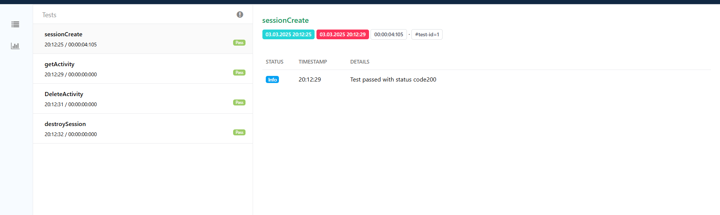
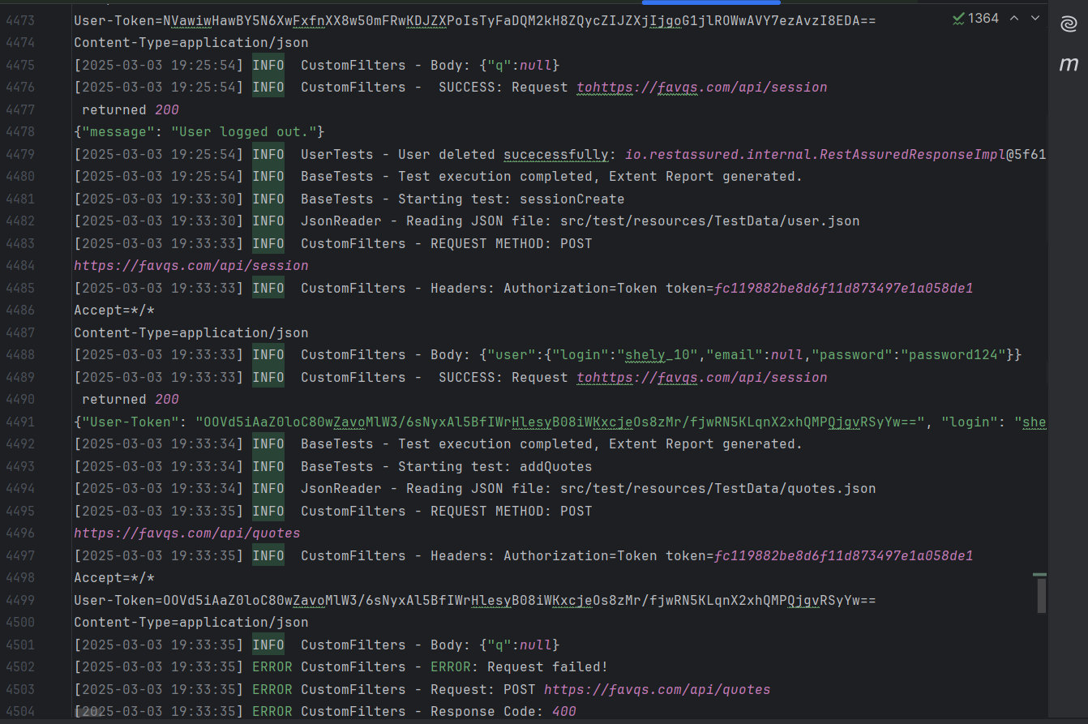
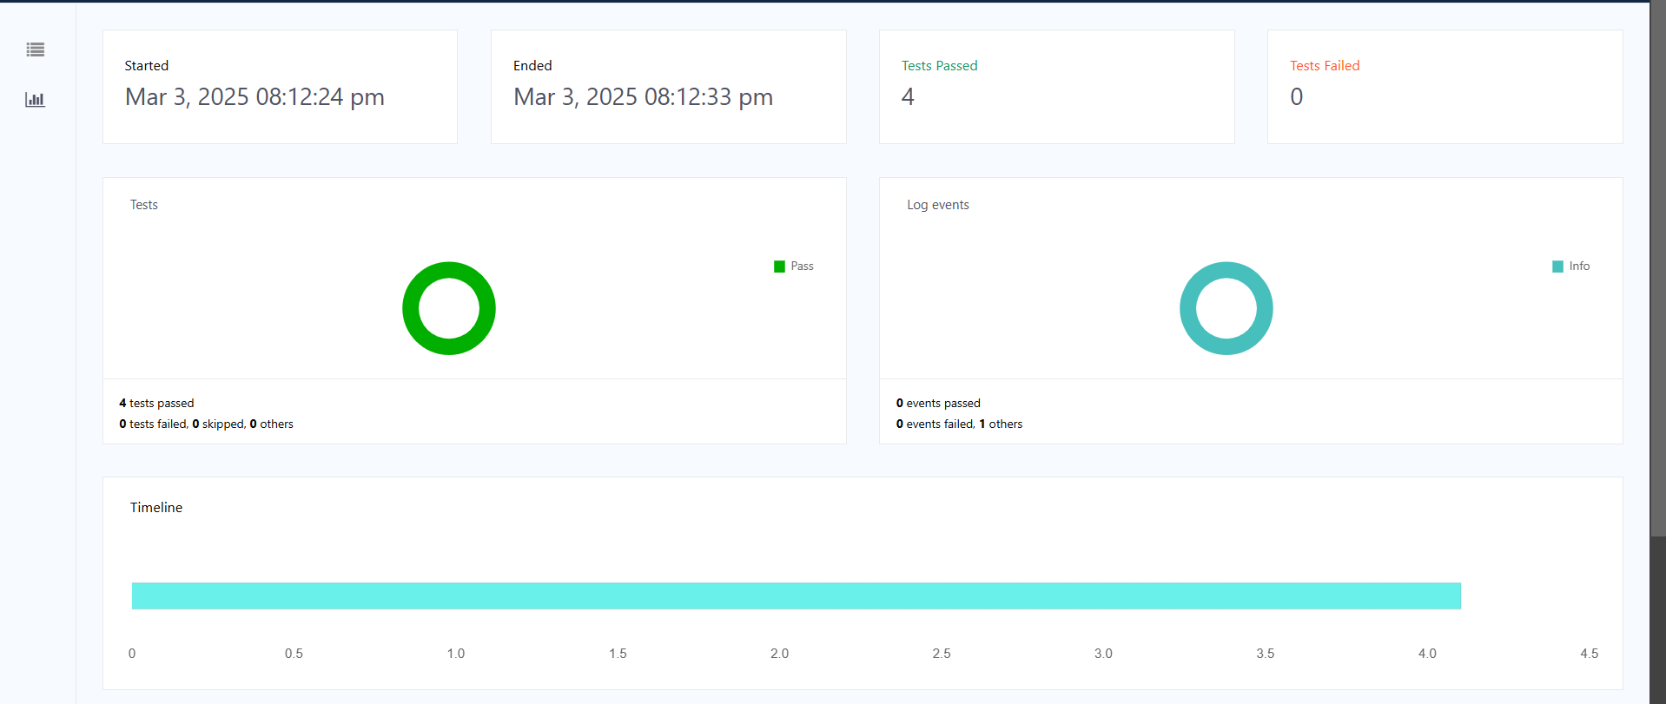
Logging & Report
Logs
Extent reports

Slide 6
Sample TestCase

Slide 7
Conclusion
Scalable & Modular Framework for API testing.
Ensures API Reliability with structured validations.
Comprehensive Reporting & Logging for debugging and monitoring.
Supports Future Enhancements for additional API endpoints.

